Slide 1
MS-601
Evolution of Management Thought

Slide 2
What is Management Thought?
Management thought can be described as the body of ideas, theories, and principles formulated for the purposes of improving the operation of an organization.
These ideas guide how managers plan, lead, organise, and control resources for the efficient attainment of goals.

Slide 3
Evolution of Management Thought
The evolution of management thought has produced varied schools-from strict rule-based classical theories to modern flexible systems that consider human emotions, creativity, and external forces.
It offers a foundation to understand modern management functions.
It helps managers make informed decisions and manage teams well.
It supports organisational goals through structured methods.

Slide 4
Historical Stages of Management Evolution

Slide 5
Classical Approach (Efficiency & Structure)
Early Management: Focused on trade, supervision, and simple division of labour during ancient civilisations.
Classical Approach (late 19th to early 20th century): Focused on factory efficiency, standard rules, and clear hierarchies. Introduced systematic principles during the industrial era.

Slide 6
Classical Approach (Efficiency & Structure)
Frederick Winslow Taylor: Known as the "Father of Scientific Management." He optimized factory tasks using time-and-motion studies to find the single most efficient way to work.
Henri Fayol: Developed administrative theory. He created the 14 Principles of Management and identified five core functions: planning, organizing, commanding, coordinating, and controlling.
Max Weber: Introduced bureaucratic management theory. He advocated for clear hierarchies, strict rules, impersonal relationships, and selection based on technical competence.
Frank and Lillian Gilbreth: Husband-and-wife duo who used motion pictures to analyze worker hand-and-body movements. They eliminated wasted motion to reduce worker fatigue and raise output.

Slide 7
Human Relations Movement (People & Motivation)
Human Relations Movement (1930s–1950s): Shifted focus to worker needs, group behavior, and job satisfaction rather than just mechanical output.
Hawthorne studies: Proved that social support and attention improve worker productivity.
Quantitative Approach (post-WWII): Applied statistics, simulations, and mathematical models to decision making.

Slide 8
Human Relations Movement (People & Motivation)
Elton Mayo: Led the famous Hawthorne Studies. He discovered that worker productivity rises when employees feel noticed, valued, and part of a supportive social group.
Abraham Maslow: Proposed the Hierarchy of Needs. He stated that managers must satisfy lower-level needs (safety, wages) before workers can be motivated by higher-level needs (recognition, growth).
Douglas McGregor: Formulated Theory X and Theory Y. Theory X assumes workers are naturally lazy and need strict control. Theory Y assumes workers are self-motivated and seek responsibility.
Mary Parker Follett: A pioneer who viewed organizations through group dynamics. She emphasized "power with" instead of "power over" employees, advocating for collaborative conflict resolution.

Slide 9
Modern Approaches (Systems & Context)
Modern Approaches: Focus on systems thinking, technology, and adaptability.
Systems theory: Views an organization as a complete, connected organism that interacts with its external environment.
Contingency thinking: Rejects one-size-fits-all rules, stating the best management style depends on the specific situation.
Technology and adaptability: Focuses on digital tools, rapid change, and global market shifts.

Slide 10
Modern Approaches (Systems & Context)
Ludwig von Bertalanffy: A biologist whose general systems theory was adapted into management. It teaches that businesses are interconnected systems; changing one part impacts the whole.
Fred Fiedler: Developed the Contingency Model of leadership. He proved that there is no single best way to manage, as leadership success depends on matching a manager's style to the specific situation.
W. Edwards Deming: Pioneered Total Quality Management (TQM) through the PDCA Cycle: Plan, Do, Check, Act loop for constant work improvement and statistical process control. Using data and statistics to monitor production, reduce variation, and eliminate defects.
Peter Drucker: Widely considered the father of modern management. He introduced Management by Objectives (MBO), predicted the rise of the "knowledge worker," and focused on decentralization.

Slide 11
Scientific Management
Frederick Taylor looked at management from the bottom-up, focusing strictly on shop-floor worker efficiency.
The 4 Principles of Taylor's Scientific Management
Science, Not Rule of Thumb: Use scientific methods to analyze work and determine the single most efficient way to perform every task.
Scientific Selection and Training: Carefully match workers to jobs based on their physical and mental capabilities, then train them to perfection.
Cooperation Over Individualism: Ensure managers and workers cooperate closely to guarantee that work is being done according to the scientific principles.
Division of Responsibility: Divide work equally between managers (who plan and design the work) and workers (who execute the physical tasks).

Slide 12
Scientific Management
Key Tools & Methods
Time and Motion Studies: Using stopwatches to break a job down into basic movements, eliminating unnecessary gestures to save time
Differential Piece-Rate System: A financial incentive where workers are paid a standard rate up to a target output, and a much higher rate per piece if they exceed that target.
Standardization: Mandating the exact tools, machinery, and workspace setups to minimize variation in output.
Pros : It radically increased industrial productivity, lowered production costs
Cons : It highly dehumanized the workplace, stripped workers of autonomy, led to extreme boredom, and caused widespread worker burnout.

Slide 13
Administrative Management
Henri Fayol shifts focus from individual factory tasks to how upper management should structure and run an entire organization.
Focus: the five functions of management- planning, organizing, commanding, coordinating, controlling
Impact: Helped managers structure organisations
Fayol’s 14 principles for smoother operations

Slide 14
Fayol’s 14 principles of management
Division of Work: Breaking tasks into smaller parts to build skill and speed.
Authority and Responsibility: Giving power to command while keeping accountability.
Discipline: Following rules and core workplace agreements.
Unity of Command: Ensuring an employee reports to only one boss.
Unity of Direction: Aligning teams behind a single unified goal.
Subordination of Individual Interest: Placing group goals above personal desires.
Remuneration: Providing fair financial and non-financial pay.
Centralization: Balancing decision-making power between top leaders and staff.
Scalar Chain: Maintaining a clear, unbroken line of command from top to bottom.
Order: Keeping materials and people in their designated locations.
Equity: Treating all workers with fairness and kindness.
Stability of Tenure: Lowering staff turnover to build stable skills.
Initiative: Allowing workers freedom to create and test ideas.
Esprit de Corps: Fostering strong team spirit, trust, and unity.

Slide 15
Bureaucratic Management
]
Max Weber introduced structure to growing industries.
Formal hierarchy
Division of labor
Rule-based decision making
Impersonality
Merit-based hiring
Impact: Created clarity in large organisations
Pros: Highly predictable results, excellent role clarity, and massive reduction in workplace favoritism.
Cons: Slow decision-making, lack of flexibility, and can frustrate creative employees.

Slide 16
Human Relations Movement
Elton Mayo
Focus: Social needs, group dynamics, and employee recognition over purely financial incentives.
Impact: Valuing employees’ psychological and emotional well-being at work
Social Interaction
Recognition
Open Communication
The Hawthorne Studies (1924-1933)
Demonstrated that giving workers special attention and improving their work environment increased output, regardless of physical lighting adjustments.

Slide 17
Contingency Approach
Fred Fiedler
Focus: Leadership success depends on matching a fixed leadership style to the specific situation.
Task-Oriented Leaders: Thrive best in extremes-either very favorable or very unfavorable situations.
Relationship-Oriented Leaders: Excel in moderate or intermediate situations that require collaboration and morale-building.
Flexibility: Emphasizes placing the right leader in the right environment rather than forcing a change in personal style.

Slide 18
Classical Approach
The classical approach focused on improving productivity and efficiency
Clear Hierarchy: Clear lines of authority from top executives down to frontline workers.
Strict Division of Labor: Tasks are broken down into highly specialized steps (each worker performs only one small task all day).
Standardized Rules: Formal procedures govern every decision
Autocratic Leadership: Managers make all decisions, and employees follow orders.
Economic Motivation: Workers are viewed as rational actors motivated primarily by money.

Slide 19
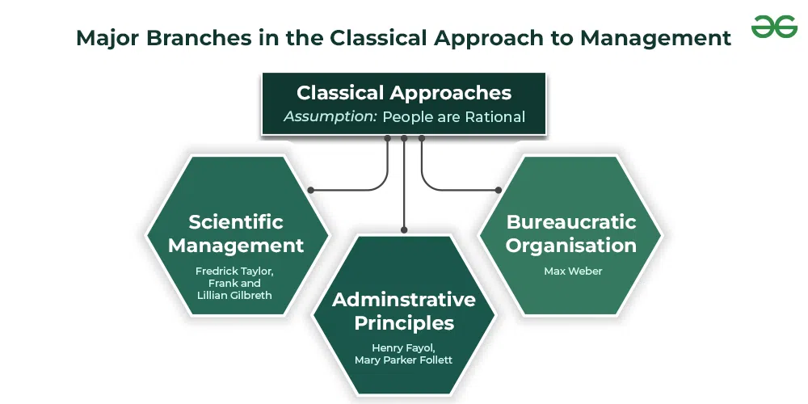
People are self-interested, have clear choices, full information, and weigh costs and benefits to make the best possible choice.

Slide 20
Criticisms of the Classical Approach
Ignored the emotional and social needs of employees
Top-down leadership discouraged creativity.
Over-reliance on structure limits flexibility

Slide 21
Modern Management Approach
Modern management blends technology, adaptable leadership, and employee satisfaction to run organizations in today’s dynamic business environment.
Digital Integration: Leveraging artificial intelligence, automation, and real-time data to drive daily execution.
Human-Centric Focus: Prioritizing employee satisfaction, engagement, and hybrid work flexibility over rigid oversight.
Sustainability and Ethics: Incorporating environmental and governance standards into corporate strategy.

Slide 22
Key Theories in the Modern Approach
Systems Theory: Views the organization as a collection of interconnected, interdependent parts working toward a shared goal.
Contingency Approach: Asserts that no single management style fits every situation; leadership must adapt based on immediate internal and external variables.
Quantitative Methods: Utilizes mathematical modeling, data analytics, and statistics to optimize operational performance and decision-making.

